Slide 1
Surprise Housing - Housing Price Predication & Analysis Project Presentation
By Pooja Jain
Fliprobo – Internship 34

Slide 2
Problem Statement
A US-based housing company named Surprise Housing has decided to enter the Australian market. The company uses data analytics to purchase houses at a price below their actual values and flip them at a higher price. For the same purpose, the company has collected a data set from the sale of houses in Australia.
It is required to build a model using Machine Learning in order to predict the actual value of the prospective properties and decide whether to invest in them or not.

Slide 3
Problem Statement
For this company wants to know:
Which variables are important to predict the price of variable?
How do these variables describe the price of the house?
How to construct a realistic model to precisely predict the price of real estate has been a challenging topic with great potential for further research.
Our main objective of doing this project is to build a model to predict the house prices with the help of other supporting features.

Slide 4
Business Goal
We are required to model the price of houses with the available independent variables.
This model will then be used by the management to understand how exactly the prices vary with the variables.
They can accordingly manipulate the strategy of the firm and concentrate on areas that will yield high returns.
Further, the model will be a good way for the management to understand the pricing dynamics of a new market.

Slide 5
Data Sources & Formats
Data set provided by Flip Robo was in the format of CSV (Comma Separated Values). There are 2 data sets that are given. One is training data and one is testing data.
1) Train file will be used for training the model, i.e., the model will learn from this file. The dimension of data is 1168 rows and 81 columns.
2) Test file contains all the independent variables, but not the target variable. The dimension of data is 292 rows and 80 columns.

Slide 6
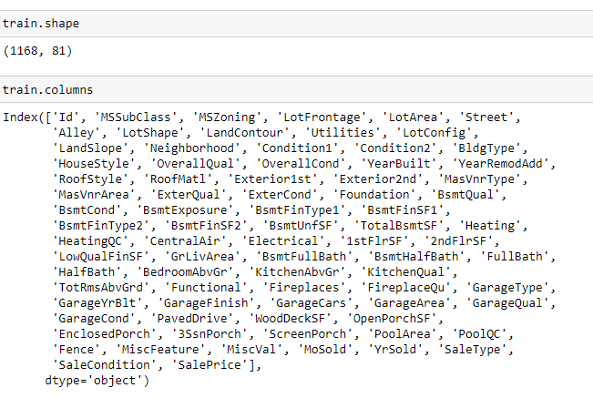

Slide 7
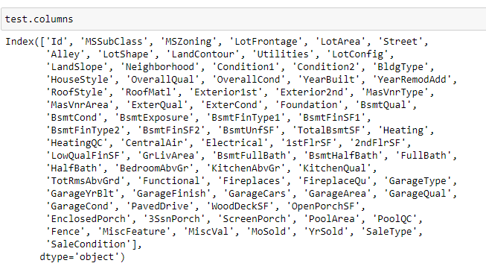

Slide 8
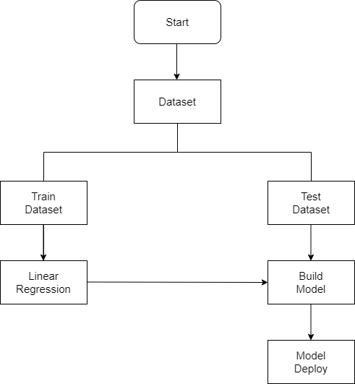
Project Flow Chart

Slide 9
Project Flow & Working
Data Integrity Check For presence of duplicate or any data error.
Missing values present in data set.
Features containing more than 80% dependency on single variable are drop from investigation.
Imputation of missing value with mean, median or mode is performed.
Feature Engineering for extraction of few new features out of existing features.
Feature selection
Label Encoding of Categorical features
Splitting of dataset into input & target feature
Standard Scaling of data

Slide 10
Exploratory Data Analysis(EDA)
In this section we go through some key insight from dataset

Slide 11
Key Observations
79.5% of House properties belongs to Low Density Residential Area followed by 14 % of properties belong to Medium Density Residential Area.
Very Few properties (0.8%) belong to Commercial zone.
Most of property for sale have overall condition rating of either 5 or 6.
We already know of 80% of housing data belongs to Low density Residential Area
Sale Price inside RL Zone is much higher than another remaining zone.
House properties having Overall condition Rating of 8 & 9 have low price compare to others. This indicate that Overall Condition Rating is Not significant factor in determination of Sale price.

Slide 12
Key Observations
89.6% of House properties are near flat level surface.
Also, price for Flat level surface house is much higher than other land contour.
Around 72 % of house comes with inside Lot configuration.
Cul-de-sac has maximum Mean Sale Price among all lot configuration.
63.4% house properties are regular in shape. Sale Price of property with slight irregular shape is higher than regular shape.
There is No Significant relationship found between Sale price & Lot area. As Overall Quality of House Increase the Sale Price of House also Increases

Slide 13
Key Observations
Cheapest Houses belong to Inside lot configuration while Costlier houses belongs to Corner Lot Configuration.
More than 950 house properties are with building type Single-family Detached.
More than 50% of house properties comes with Overall Condition Rating of 5.
More than 75% of house properties come with overall Quality Rating varies between 5 to 6.
More than 500 House Properties comes with one story dwelling.
Around 1000 sales happen by Conventional Warranty Deed.
Home just constructed and sold category are exceptionally much costlier than anyone else.

Slide 14
Key Observations
All loan-based sale is below 300000.
We can see that Sale with condition like Abnorml, Family, Alloca, AdjLand are below the price of 300000.
Maximum Base Price for House comes from Partial category- (associated with Uncompleted New Home) is higher than rest.
Minimum base price comes from Normal condition sale and also highest sale price comes from this category.
As total floor area increases the sale price also get increases corresponding the overall quality of House.
More than 75% House properties come with Gable Roof Style followed by around 15 % house properties with Hip Style.
Hip style Roof are much costlier than remaining roof style

Slide 15
Key Observations
For High floor area construction mainly Hip style Roof is used and invariably high-cost properties mostly comes up with Hip Style Roof.
More than 90% Properties in Data set made with roof material of Standard (Composite) Shingle.
Wood Shingles is Costlier Material compare to rest.
Around 60% of house properties come with Average Exterior quality and all of them below 400000.
Very few House Properties comes with Excellent Exterior Quality.
Costlier house properties come with Good & Excellent exterior quality.

Slide 16
Key Observations
44.2% Properties with CBlock Foundation & 43.9% housing property come with PConc Foundation.
Pconc Foundation are mostly use in costly housing properties.

Slide 17
Machine Learning Model Building

Slide 18
Machine Learning Algorithm Used
Linear Regression
Random Forest Regressor
Decision Tree Regressor
Ridge Regression
XGB Regressor
Extra Tree Regressor
Lasso

Slide 19
Machine Learning Model Building Flow
Standard Scaling of Data
Splitting Training Data Using test_train_split
Finding Best Random state
Training ML Model on Different Algorithms
10 Fold Cross Validation of Different Model
Selection of Best Model Based on Evaluation Criteria
Hyper Parameter Tuning of Best Model
Saving final Model Using Joblib
Predicating Test Dataset using Final Model

Slide 20
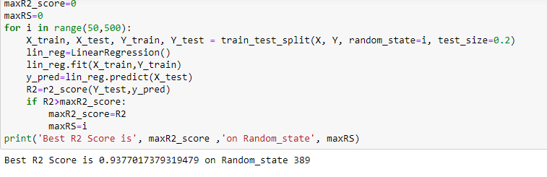
Getting Best R2 Score and Random State

Slide 21
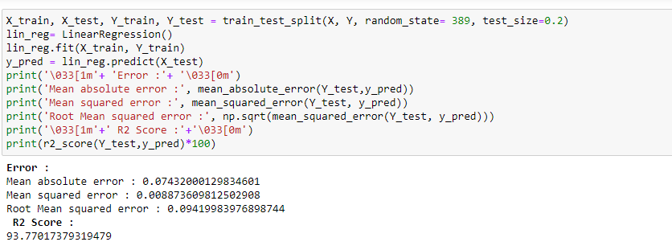
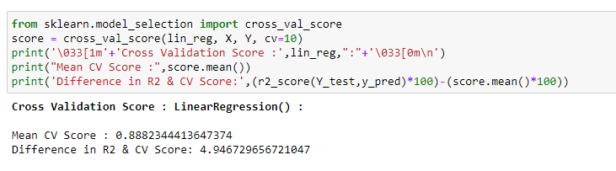
Linear Regression

Slide 22
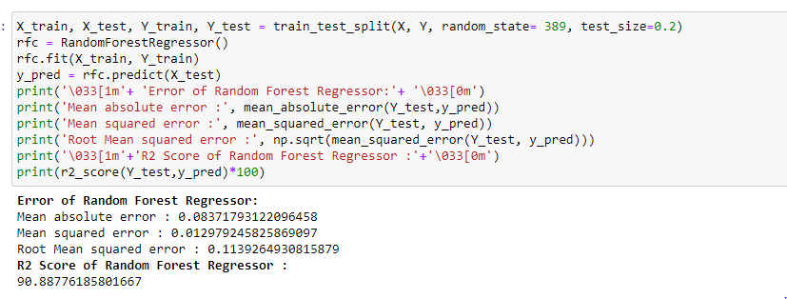
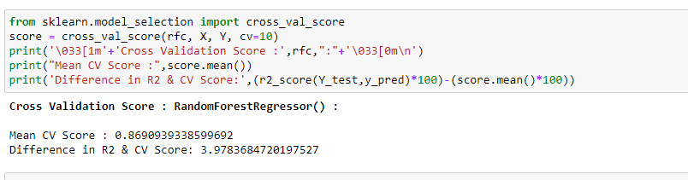
Random Forest Regressor

Slide 23
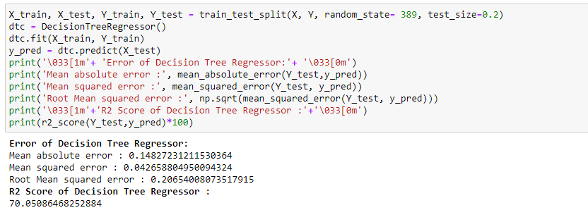
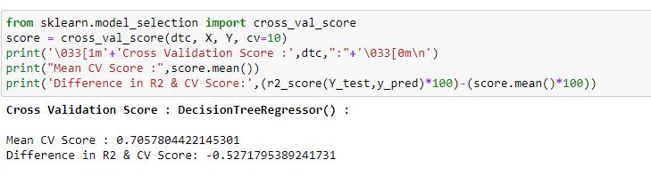
Decision Tree Regressor

Slide 24
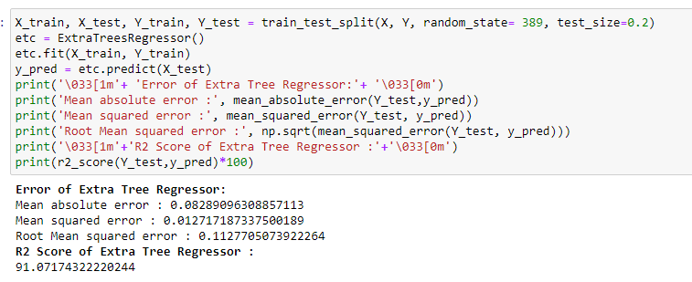
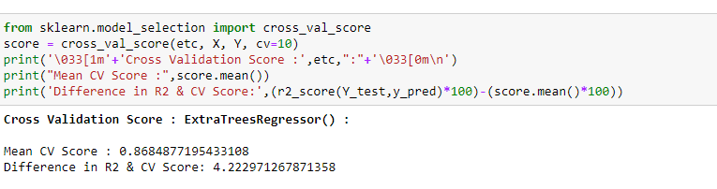
Extra Tree Regressor

Slide 25
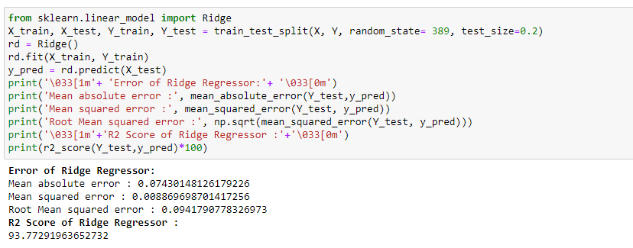
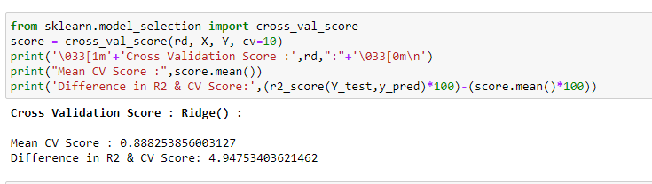
Ridge Regression

Slide 26
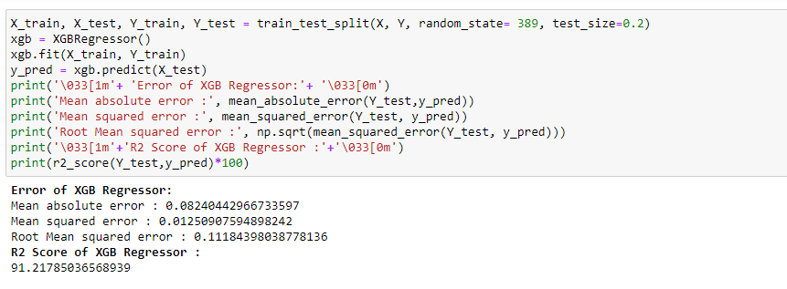
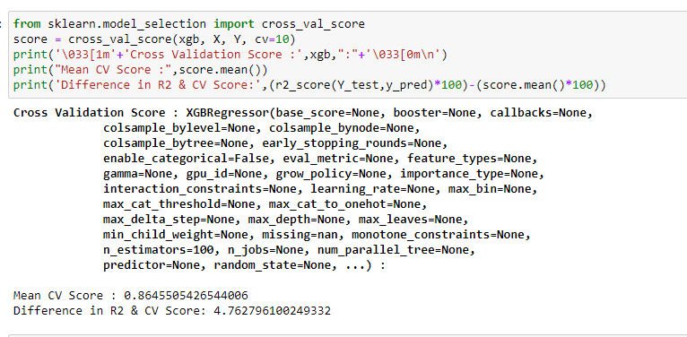
XGB Regressor

Slide 27
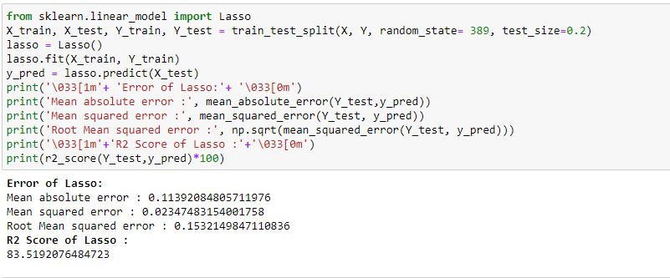
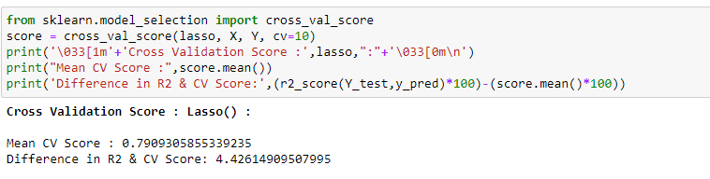
Lasso

Slide 28
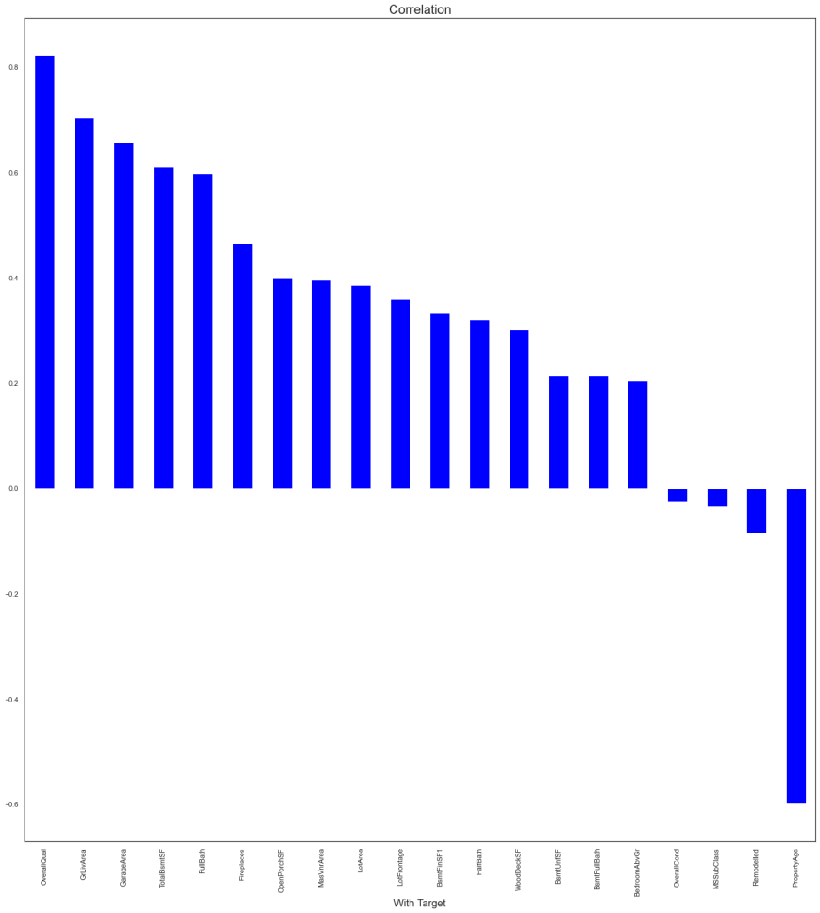
Visualizations

Slide 29
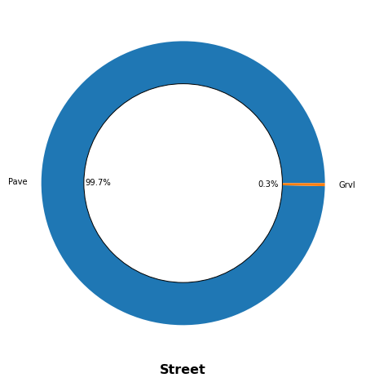

Slide 30
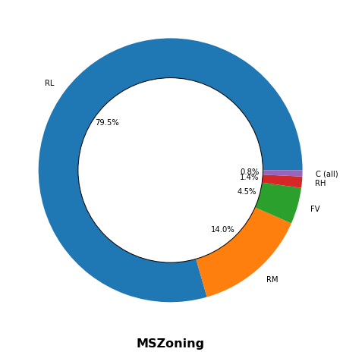

Slide 31
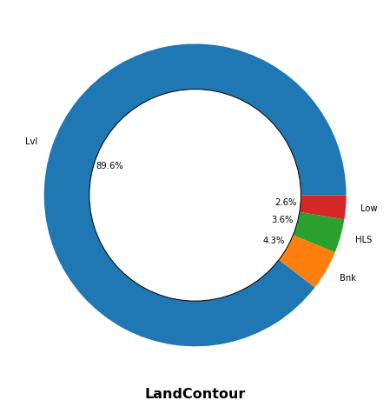

Slide 32
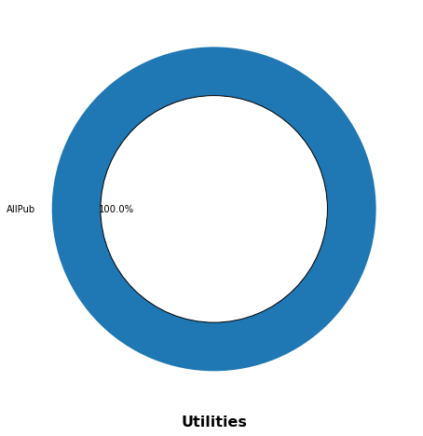

Slide 33
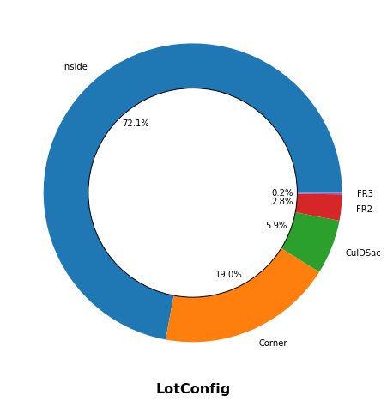

Slide 34
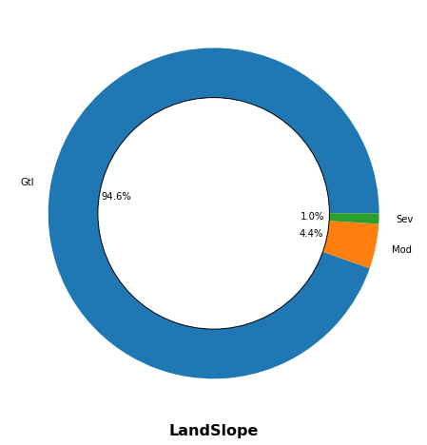

Slide 35
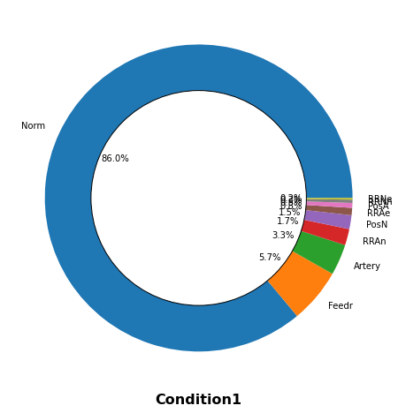

Slide 36
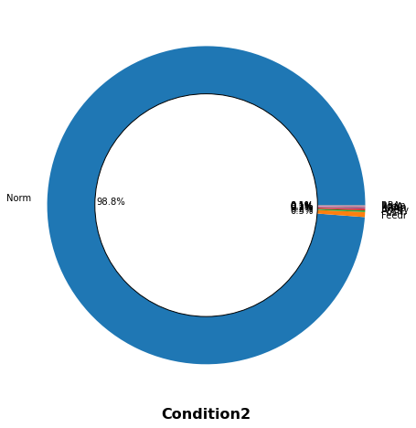

Slide 37
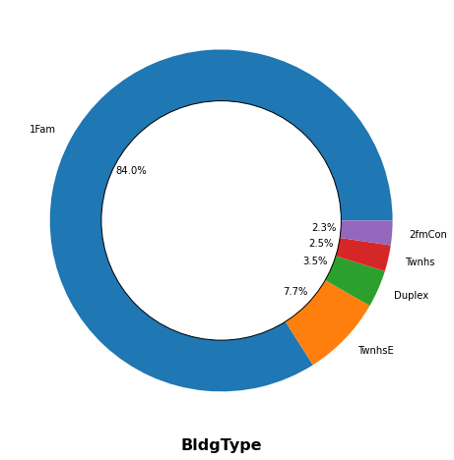

Slide 38
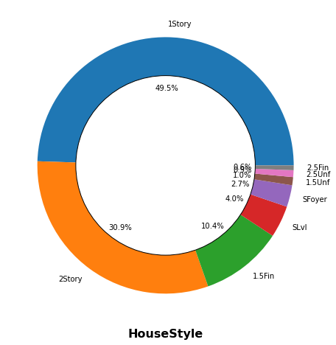

Slide 39
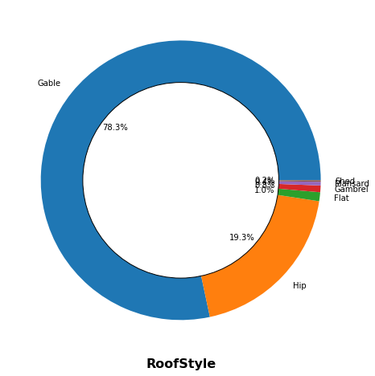

Slide 40
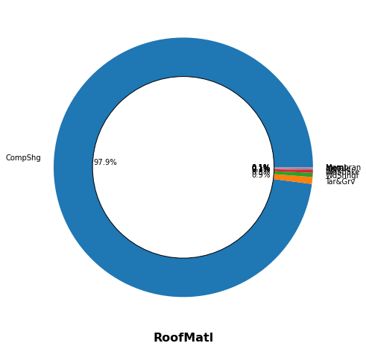

Slide 41
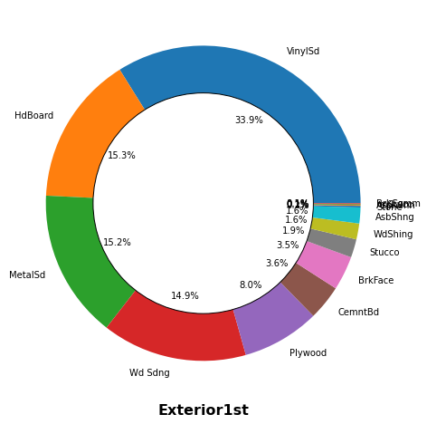

Slide 42
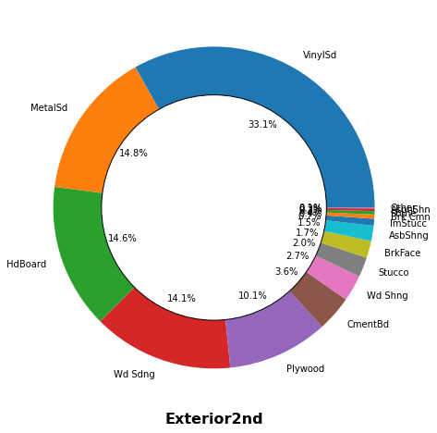

Slide 43
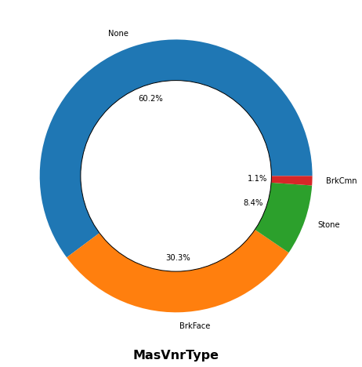

Slide 44
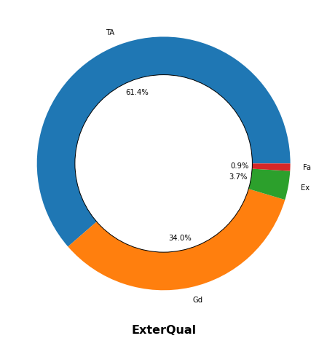

Slide 45
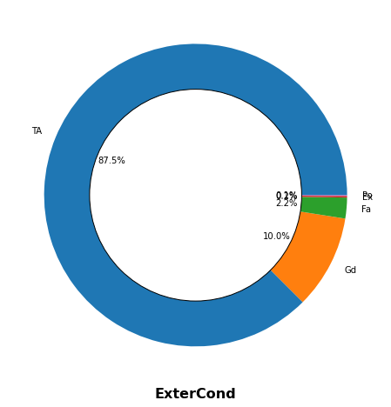

Slide 46
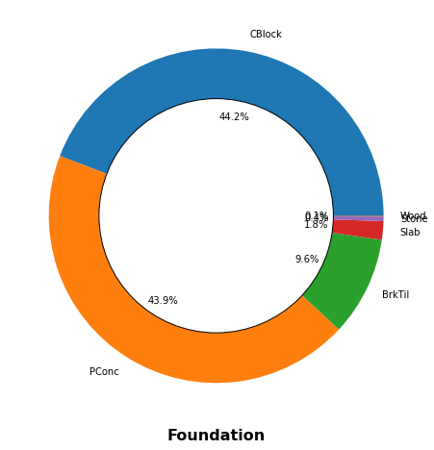

Slide 47
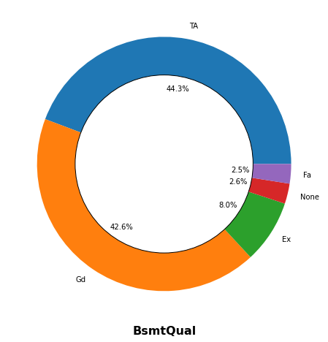

Slide 48
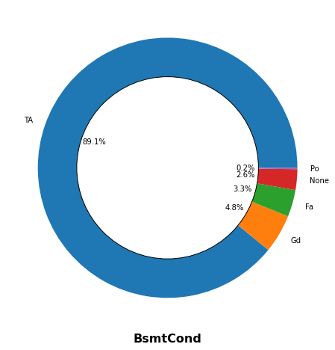

Slide 49
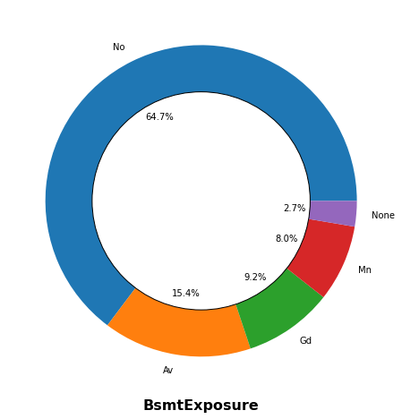

Slide 50
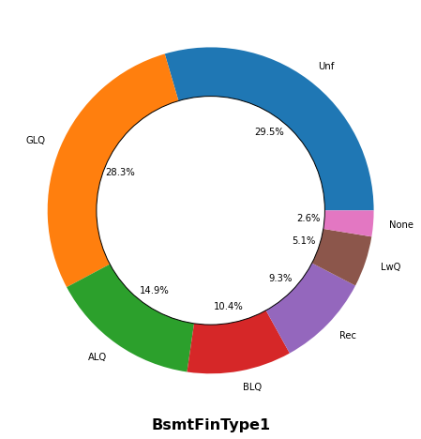

Slide 51
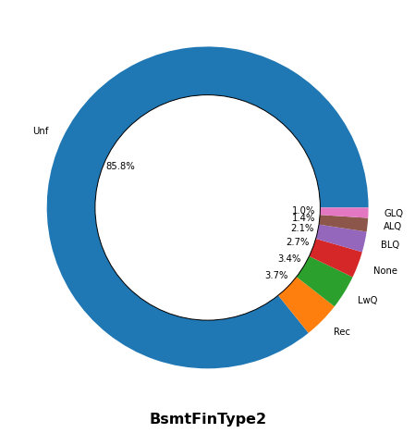

Slide 52
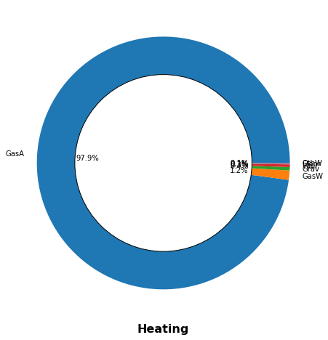

Slide 53
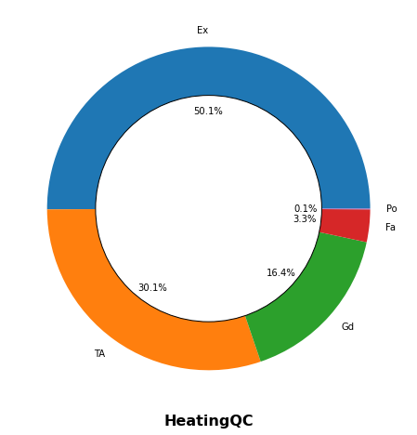

Slide 55
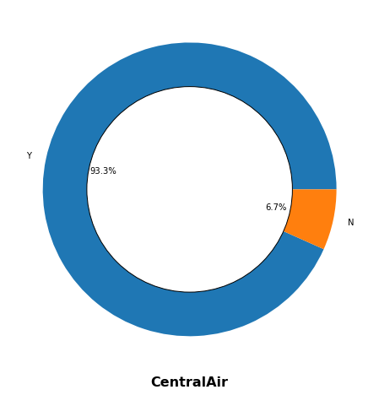

Slide 56
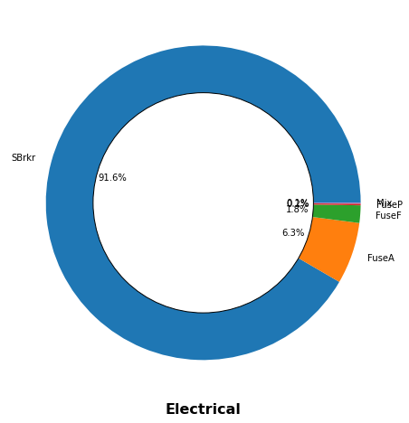

Slide 57
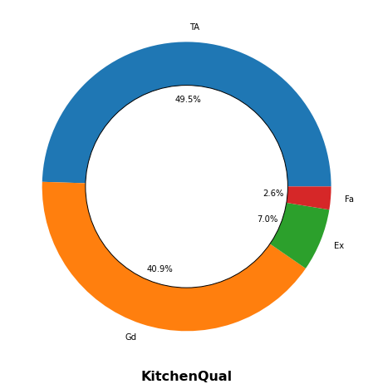

Slide 58
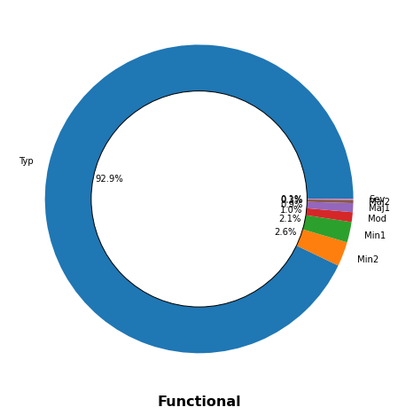

Slide 60
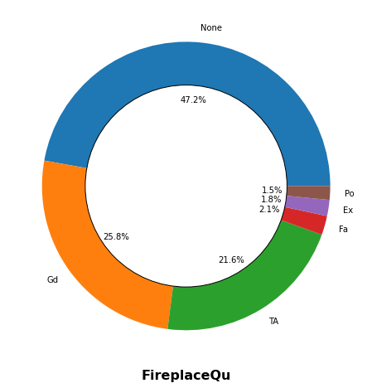

Slide 61
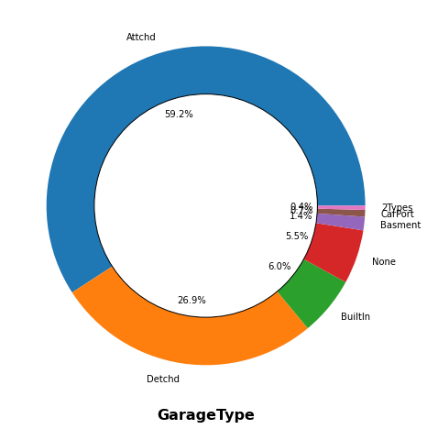

Slide 62


Slide 63


Slide 64


Slide 65


Slide 66


Slide 67


Slide 68


Slide 69


Slide 70


Slide 71


Slide 72


Slide 73


